Slide 1

RISK MANAGEMENT IN PROJECT
Plan Risk Management
Identify Risk
Perform Qualitative Risk
Perform Quantitative Risk
Plan Risk Response
Control Risk

Slide 2
Risk Management Plan must Include
Methodology- Describes how you will perform risk management, including elements such as methods , tools and where you can find the risk data that can be used for later process.
Roles and responsibilities-people responsible for managing and identifying risk and their responses for each type of activity identified in the risk management plan. They may be other than project team.
Budgeting-included in plan ,assign resources and estimate the cost including contingency reserves.
Timing-includes where and how the risk is occurring in project .
Risk categories-Type of risk
Definitions of risk probability and impact-occurrence and impact
Probability and Impact matrix
Revised stakeholder tolerances-tolerance level change as we proceed and need to be recorded.
Reporting formats-contents of risk register
Tracking

Slide 3
Causes of risk
First, subprocess 7 is almost invariably ignored. Second, risk identifi cation activities routinely (1) fail to consider risks associated with the project’s external environment and
Focus on misfortune, overlooking the risk of positive things happening.

Slide 4
Risk management is “the systematic process of identifying, analyzing, and responding to project risk” and consists of six subprocesses, and, as we shall see below, a seventh subprocess needs to be added.
1. Risk Management Planning—deciding how to approach and plan the risk management activities for a project.
2. Risk Identification—determining which risks might affect the project and documenting their characteristics.
3. Qualitative Risk Analysis—performing a qualitative analysis of risks and conditions to prioritize their impacts on project objectives.
4. Quantitative Risk Analysis—estimating the probability and consequences of risks and estimating the implications for project objectives.
5. Risk Response Planning—developing procedures and techniques to enhance opportunities and reduce threats to the project’s objectives.
6. Risk Monitoring and Control—monitoring residual risks, identifying new risks, executing risk reduction plans, and evaluating their effectiveness throughout the project life cycle.
7. Create and Maintain a Risk Management Data Bank—a permanent record of identified risks, methods used to mitigate or resolve them, and the results of all risk management activities.

Slide 5
RISK IDENTIFICATION
Risk Categories
Tools to identify risks

Slide 6
Risk identification
the risk management system should maintain an up-to-date data bank that includes, but is not restricted to, the following:
identification of all environments that may impact on the project
identification of all assumptions made in the preliminary project plan that may be the source of risk for the project
all risks identified by the risk management group, complete with their estimated impacts on the project and estimates of their probability of occurring
a complete list of all “categories” and “key words” used to categorize risks, assumptions, and environments so that all risk management groups can access past work done on risk management
the details of all qualitative and quantitative estimates made on risks, on states of the project’s environment, or on project assumptions, complete with a brief description of the methods used to make such estimates • minutes of all group meetings including all actions the group developed to deal with or mitigate each specific risk, including the decision to ignore a risk
the actual outcomes of estimated risks and the results of actions taken to mitigate risk

Slide 7
Risk categories
Technical , quality, performance risk.
Project Management risk
Organizational risk
External risk

Slide 8
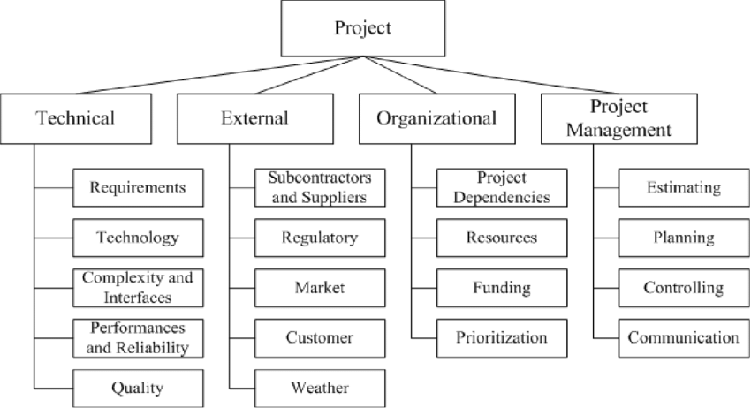
Risk Breakdown Structure

Slide 9
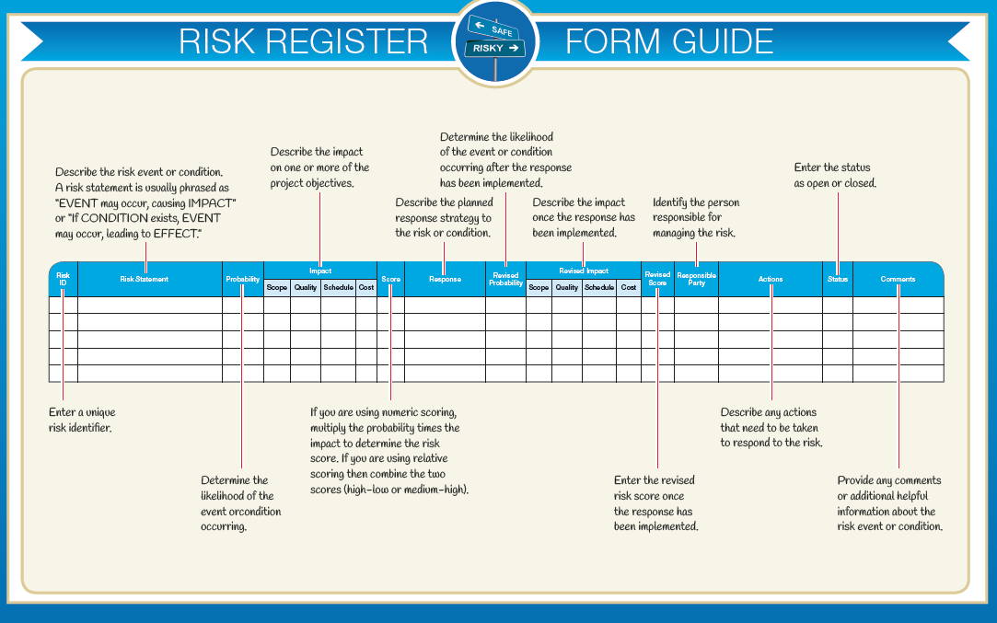
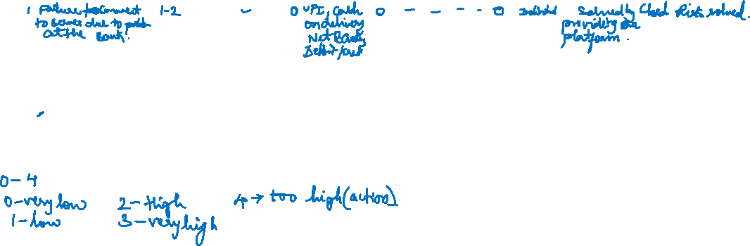
Risk register

Slide 10
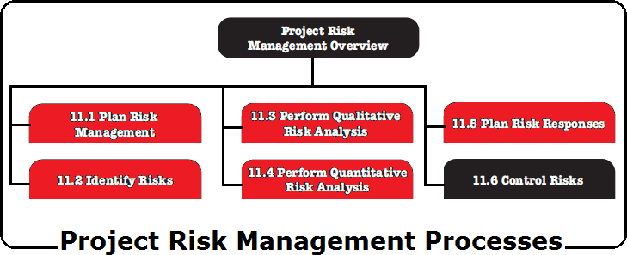
Project Risk Manaement
To be successful, an organization should be committed to address risk management proactively and consistently throughout the project.
Project Risk could exist at the moment a project is initiated. Moving forward on a project without a proactive focus on risk management is likely to lead to more problems arising from unmanaged threats.

Slide 11

Project Risk Management Knowledge Area
Risk Management's General Concepts -
Project risk is an uncertain event or condition that, if it occurs, has a positive or negative effect on one or more project objectives such as scope, schedule, cost, & quality.
A risk may have one or more causes and, if it occurs, it may have one or more impacts.
A cause may be a given or potential requirement, assumption, constraint, or condition that creates the possibility of negative or positive outcomes.
Overall project risk is more than the sum of the individual risks within a project, since it includes all sources of project uncertainty. It represents the exposure of stakeholders to the implications of variations in project outcome, both positive and negative.
The objectives of project risk management are to increase the likelihood and impact of positive events, and decrease the likelihood and impact of negative events in the project.

Slide 12


Project Risk Management Knowledge Area
Risk Management's General Concepts -
The Project risk has its origins in the uncertainty present in all projects,
Known risks are those that have been identified and analyzed, making it possible to plan responses for those risks.
Risks & Contingency Reserve – Known Risks that cannot be managed proactively,
should be assigned a contingency reserve. [Known – Unknowns]
Risks & Management Reserve - Unknown Risks cannot be managed proactively and therefore may be assigned a management reserve. [Unknown – Unknowns]
An issue - A negative project risk that has occurred is considered an issue.

Slide 13
Project Risk Management Knowledge Area
Risk Management's General Concepts
The risk attitudes -
Organizations perceive risk as the effect of uncertainty on projects & organizational objectives.
Organizations and stakeholders are willing to accept varying degrees of risk depending on their risk attitude.
The risk attitudes of both the organization & the stakeholders may be influenced by a number of factors, which are broadly classified into three themes:
Risk Appetite - The degree of uncertainty an entity is willing to take on in anticipation of a
reward.
Risk Tolerance - The degree, amount, or volume of risk that an organization or individual will withstand / hold out.
Risk Threshold - Which refers to measures along the level of uncertainty or the level of impact at which a stakeholder may have a specific interest. Below that risk threshold, the organization will accept the risk. Above that risk threshold, the organization will not tolerate the risk.
The project may be accepted if the risks are within tolerances and are in balance with the rewards that may be gained by taking the risks.

Slide 14


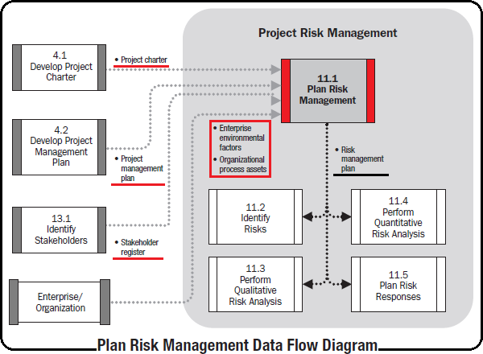
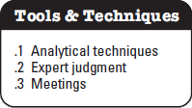
Plan Risk Management Data Flow Diagram
The process of defining how to conduct risk management activities for a project.
It ensures that the degree, type, and visibility of risk management are commensurate with both the risks and the importance of the project to the organization.
To ensure support and perform an effective Risk Management Process over the project life cycle it is vital to obtaining the agreement and support of all stakeholders.

Slide 15
Plan Risk Management Inputs
The project management plan - Provides baseline or current state of risk-affected areas including scope, schedule, and cost.
– All approved subsidiary management plans and baselines should be taken into consideration in order to make the risk management plan consistent with them.
Project Charter - Provide various inputs such as high-level risks, high-level project descriptions, and high-level requirements.
Stakeholder Register - Contains all details related to the project’s stakeholders, provides
an overview of their roles.
Enterprise Environmental Factors - Include, but are not limited to, risk attitudes, thresholds, and tolerances that describe the degree of risk that an organization will withstand.
Organizational Process Assets - Risk categories, Common definitions of concepts and terms, Risk statement formats, Standard templates, Roles and responsibilities, Authority levels for decision making, and Lessons learned.

Slide 16
Plan Risk Management Tools & Techniques (T&T)
–
Risk management context is a combination of stakeholder risk attitudes and the strategic risk exposure of a given project based on the overall project context. Ex. A stakeholder risk profile analysis may be performed to grade and qualify the project stakeholder risk appetite and tolerance. Other techniques, such as the use of strategic risk scoring sheets, are used to provide a high-level assessment of the risk exposure of the project based on the overall project context.
Depending on these assessments, the project team can allocate appropriate resources and focus on the risk management activities.
–
Expert Judgment - To ensure a comprehensive establishment of the risk management plan. Ex.
Senior management, Project stakeholders, Subject matter experts (SMEs).
Meetings - Project teams hold planning meetings to develop the risk management plan.
–
–
High-level plans for conducting the risk management activities are defined in these meetings.
Risk management cost elements and schedule activities should be developed for inclusion in the project budget and schedule, respectively.
Risk contingency reserve application approaches may be established or reviewed.
Risk management responsibilities should be assigned.
General organizational templates for risk categories and definitions of terms such as levels of risk, probability by type of risk, impact by type of objectives, and the probability and impact matrix will be tailored to the specific project.
The outputs of these activities are summarized in the risk management plan.
–
–
–
–

Slide 17

Plan Risk Management Outputs
Risk Management Plan - Describes how risk management activities will be structured and performed. Includes,
Methodology - Defines the approaches, tools, and data sources that will be used to perform
risk management on the project.
Roles and responsibilities -
Budgeting - Estimates funds needed, based on assigned resources, for inclusion in the cost
baseline and establishes protocols for application of contingency and management reserves.
Timing - Defines when and how often the risk management processes will be performed throughout the project life cycle, establishes protocols for application of schedule contingency reserves, and establishes risk management activities for inclusion in the project schedule.
Risk categories - Provide a means for grouping potential causes of risk.
Structure based on project objectives by category.
A risk breakdown structure (RBS) is a hierarchical representation of risks according to their risk categories.

Slide 18
Plan Risk Management Outputs
Risk Management Plan - Describes how risk management activities will be structured and performed. Includes,
Definitions of risk probability and impact - The quality and credibility of the risk analysis requires that different levels of risk probability and impact be defined that are specific to the project context.
Probability and impact matrix - A probability and impact matrix is a grid for mapping the probability of each risk occurrence and its impact on project objectives if that risk occurs.
Revised stakeholders’ tolerances - Stakeholders’ tolerances, as they apply to the specific project, may be revised in the Plan Risk Management process.
Reporting formats - Describes the content and format of the risk register as well as any other risk reports required.
Tracking - Tracking documents how risk activities will be recorded for the benefit of the current project and how risk management processes will be audited.

Slide 19
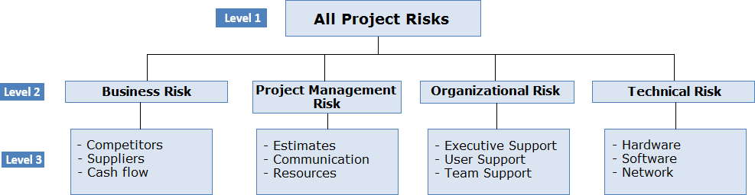
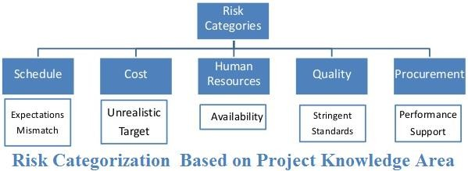
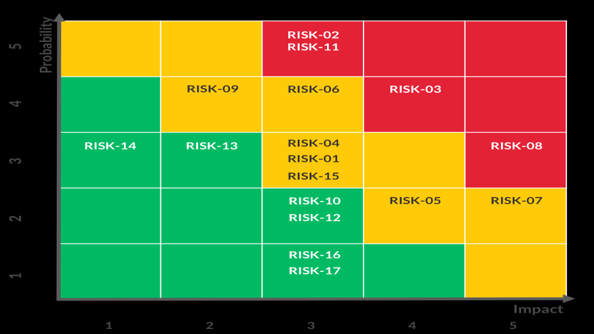
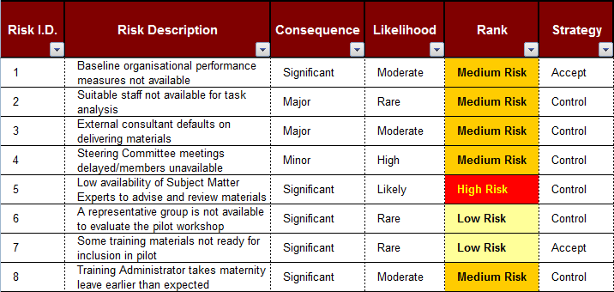
Plan Risk Management Outputs

Slide 20
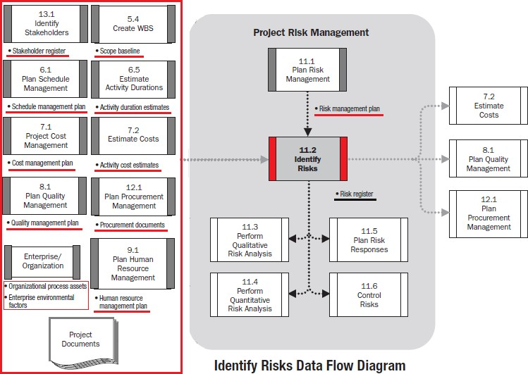
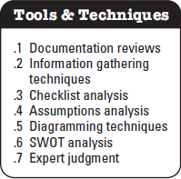

Identify Risks
Data Flow Diagram
The process of determining which risks may affect the project and documenting their characteristics.
It provides the knowledge and ability for the project team to anticipate the Risk's events through documentation.

Slide 21

Identify Risks General Notes
Identify risks is an iterative process, because new risks may evolve or become known as the project progresses through its life cycle.
The process should involve the project team so they can develop and maintain a sense of ownership and responsibility for the risks and associated risk response actions.
Stakeholders outside the project team may provide additional objective information.
The risk statements format should be consistent to ensure that each risk is understood clearly and unambiguously in order to support effective analysis and response development.

Slide 22


Identify Risks Inputs
Project Management Plan,
Risk Management Plan,
Cost Management Plan,
Schedule Management Plan,
Quality Management Plan,
Human Resource Management Plan,
Scope Baseline - Project assumptions are found in the project scope statement. The WBS is a critical input to identifying risks as it facilitates an understanding of the potential risks at both the micro and macro levels. Risks can be identified and subsequently tracked at summary, control account, and/or work package levels.
Activity Cost Estimates - They provide a quantitative assessment of the likely cost to complete scheduled activities and ideally are expressed as a range, with the width of the range indicating the degree(s) of risk.

Slide 23
Identify Risks Inputs
Activity Duration Estimates - Identifying risks related to the time allowances for the activities or project as a whole.
Stakeholder Register - To ensure that key stakeholders, especially the stakeholder, sponsor, and customer are interviewed or otherwise participate during the Identify Risks process.
Project Documents - Project charter, Project schedule, Schedule network diagrams, Issue log, Quality checklist...
Procurement Documents - The complexity and the level of detail of the procurement documents should be consistent with the value of, and risks associated with, planned procurement.
Enterprise Environmental Factors
Organizational Process Assets

Slide 24

Identify Risks
Tools & Techniques (T&T)
Documentation Reviews - The quality of the plans, as well as consistency between those plans and the project requirements and assumptions, may be indicators of risk in the project.
Information Gathering Techniques -
Brainstorming.
The goal of brainstorming is to obtain a comprehensive list of project risks.
The project team usually performs brainstorming, often with a multidisciplinary set of experts who are not part of the team.
Ideas about project risk are generated under the leadership of a facilitator, either in a traditional
free-form brainstorm session or structured mass interviewing techniques.
Categories of risk, such as in a risk breakdown structure, can be used as a framework.
Risks are then identified and categorized by type of risk and their definitions are refined.
Delphi technique. A way to reach a consensus of experts.
Project risk experts participate in this technique anonymously.
A facilitator uses a questionnaire to solicit ideas about the important project risks.
The responses are summarized and are then recirculated to the experts for further comment.
Consensus may be reached in a few rounds of this process.
The Delphi technique helps reduce bias in the data and keeps any one person from having undue influence on the outcome.
1.

Slide 25
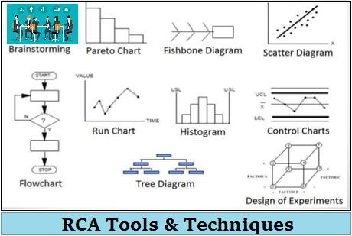
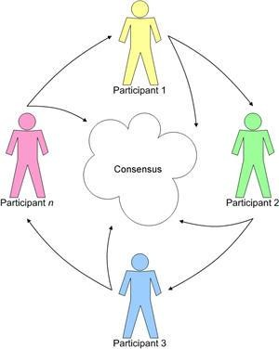
Identify Risks
Tools & Techniques (T&T)
1. Information Gathering Techniques -
3.
Interviewing - Interviewing experienced project participants, stakeholders, and subject matter experts helps to identify risks.
Root cause analysis (RCA) - method of problem solving - used to identify a problem, discover the underlying causes that lead to it, and develop preventive action.
4.

Slide 26
Identify Risks
Tools & Techniques (T&T)
3. Checklist Analysis
– Risk identification checklists are developed based on historical information and knowledge that has been accumulated from previous similar projects and from other sources of information.
The lowest level of the RBS can also be used as a risk checklist.
Care should be taken to ensure the checklist is not used to avoid the effort of proper risk identification.
The checklist should be reviewed during project closure to incorporate new lessons learned
and improve it for use on future projects.
–
–
–
Assumptions Analysis - To identifies risks to the project from inaccuracy, instability, inconsistency, or incompleteness of assumptions.
SWOT Analysis - This technique examines the project from each of the strengths, weaknesses, opportunities, and threats (SWOT) perspectives to increase the breadth of identified risks by including internally generated risks.
Expert Judgment - Note: The experts’ bias should be taken into account in this process.

Slide 27
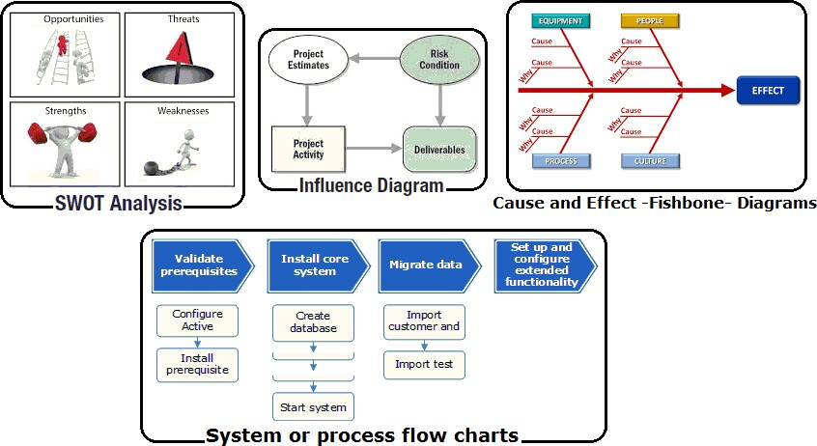
Identify Risks
Tools & Techniques (T&T)
7. Diagramming Techniques

Slide 28
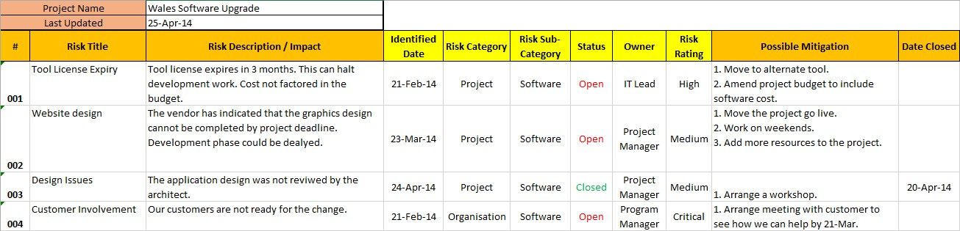
Identify Risks Outputs
Risk Register -
The preparation of the risk register begins in the Identify Risks process with the following information, and then becomes available to other project management and risk management processes:
List of identified risks.
The identified risks are described in as much detail as is reasonable.
In addition to the list of identified risks, the root causes of those risks may become more evident.
List of potential responses.
- Potential responses to a risk may sometimes be identified during the Identify Risks process. These responses, if identified in this process, should be used as inputs to the Plan Risk Responses process.

Slide 29


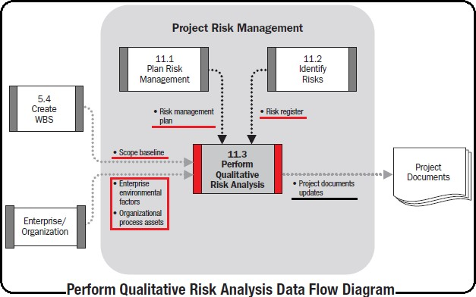
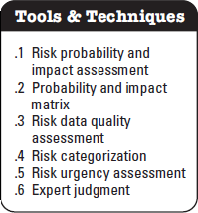
Perform Qualitative Risk Analysis Data Flow Diagram
Perform Qualitative Risk Analysis is the process of prioritizing risks for further analysis or action by assessing and combining their probability of occurrence and impact.
It enables project managers to reduce the level of uncertainty and to focus on high-priority risks.

Slide 30

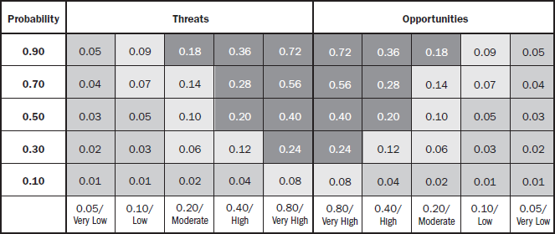

Perform Qualitative Risk Analysis Tools & Techniques (T&T)
1. Risk Probability and Impact Assessment -
Risk probability assessment investigates the likelihood that each specific risk will occur.
Risk impact assessment investigates the potential effect on a project objective such as schedule, cost, quality, or performance, including both negative effects for threats and positive effects for opportunities.
Assessment Steps
–
–
The level of probability for each risk and its impact on each objective is evaluated during the interview or meeting. Project team members and knowledgeable persons external to the project are included.
Risk probabilities and impacts are rated according to the definitions given in the risk management plan.
Risks with low ratings of probability and impact will be included within the risk register as part of the watch list for future monitoring.
–
●
●
●
Probability and Impact Matrix -
Each risk is rated on its probability of occurrence and impact on an objective if it does occur.
The organization should determine which combinations of probability and impact result in a classification of high risk, moderate risk, and low risk.
The risk-rating rules are specified by the organization in advance of the project and included in organizational process assets.
Risk rating rules can be tailored in the Plan Risk Management process to the specific project.

Slide 31
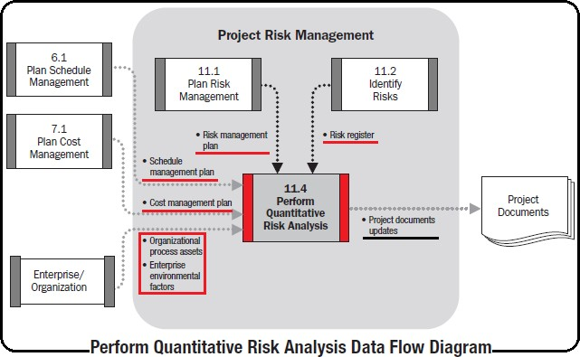
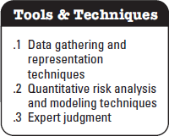

Perform Quantitative Risk Analysis Data Flow Diagram
The process of numerically analyzing the effect of identified risks on overall project objectives.
It produces quantitative risk information to support decision making in order to reduce project uncertainty.

Slide 32

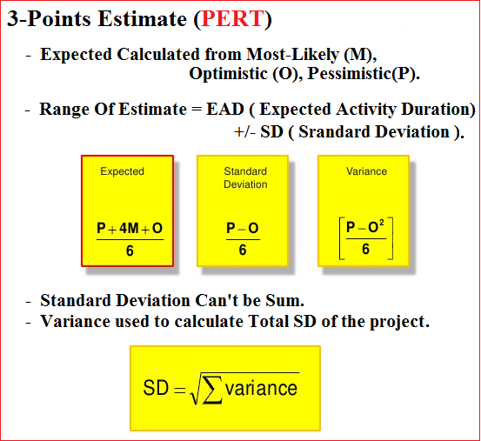
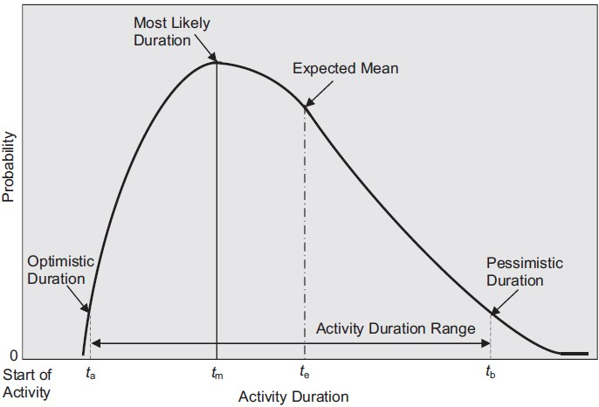
Perform Quantitative Risk Analysis Tools & Techniques (T&T)
Data Gathering and Representation Techniques -
Interviewing techniques - Draw on experience and historical data to quantify the probability and
impact of risks on project objectives. Ex. Three-point estimates (PERT)
Probability distributions - Continuous probability distributions - Used extensively in modeling and simulation, represent the uncertainty in values such as durations of schedule activities and costs of project components. It can be used to represent uncertain events, such as the outcome of a test or a possible scenario in a decision tree.

Slide 33
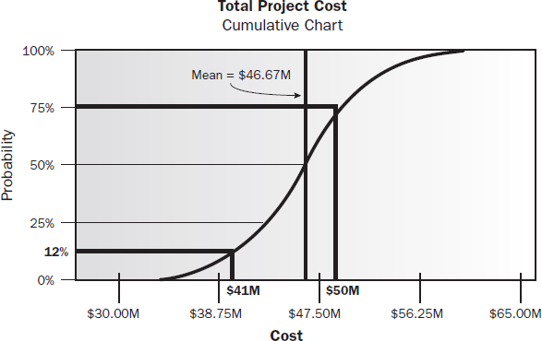
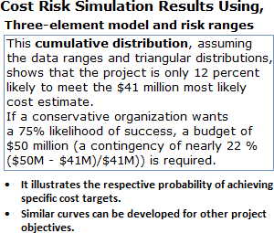
Perform Quantitative Risk Analysis Tools & Techniques (T&T)
2. Quantitative Risk Analysis and Modeling Techniques -
III. Modeling and simulation - Uses a model that translates the specified detailed uncertainties of the project into their potential impact on project objectives. Simulations are typically performed using The Monte Carlo technique.

Slide 34
Perform Quantitative Risk Analysis Tools & Techniques (T&T)
4. Expert Judgment - The ideally using experts with relevant, recent experience is required to identify potential cost and schedule impacts, to evaluate probability, and to define inputs such as probability distributions into the tools.
- Expert judgment also comes into play in the interpretation of the data and identify the weaknesses of the tools as well as their strengths.

Slide 35
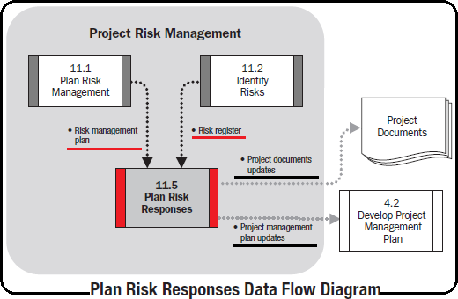
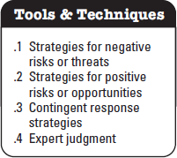

Plan Risk Responses Data Flow Diagram
The process of developing options and actions to enhance opportunities & to reduce threats to project objectives.
It addresses the risks by their priority, inserting resources and activities into the budget, schedule and project management plan as needed.
It follows the Perform Quantitative Risk Analysis process (if used).

Slide 36

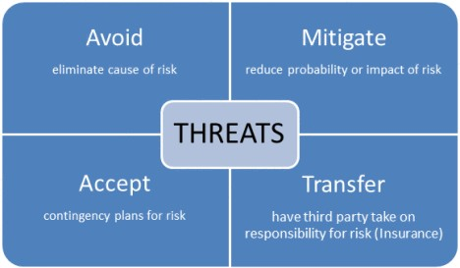

Plan Risk Responses Tools & Techniques (T&T)
Strategies for Negative Risks or Threats -

Slide 37
Plan Risk Responses Tools & Techniques (T&T)
Strategies for Negative Risks or Threats -
1. Avoid - The project team acts to eliminate the threat or protect the project from its impact.
I.
Some risks that arise early in the project can be avoided by clarifying requirements, obtaining information, improving communication, or acquiring expertise.
The project manager may isolate the project objectives from the risk’s impact or change the objective that is in jeopardy through changing the project management plan. For Ex.
Extending the schedule, changing the strategy, or reducing scope.
II.
III. The most radical avoidance strategy is to shut down the project entirely.
2. Mitigate - The project team acts to reduce the probability of occurrence or impact of an adverse risk to be within acceptable threshold limits.
Taking early action to reduce the probability and/or impact of a risk occurring on the project is often more effective than trying to repair the damage after the risk has occurred.
II. Where it is not possible to reduce probability, a mitigation response might address the risk impact by targeting linkages that determine the severity.
Example of mitigation actions, Adopting less complex processes, conducting more tests, or choosing a more stable supplier, using prototype …
I.

Slide 38
Plan Risk Responses Tools & Techniques (T&T)
Strategies for Negative Risks or Threats -
3. Transfer - The project team shifts the impact of a threat to a third party, together with ownership of the
response.
I.
Transferring the risk simply gives another party responsibility for its management—it does not eliminate it.
Transferring does not mean disowning the risk by transferring it to a later project or another person without his or her knowledge or agreement.
II.
Transference tools may include, the use of insurance, performance bonds, warranties, guarantees, etc.
Contracts or agreements may be used to transfer liability for specified risks to another party.
In many cases, use of a cost-plus contract may transfer the cost risk to the buyer, while a fixed-price contract may transfer risk to the seller.
4. Accept. The project team decides to acknowledge the risk and not take any action unless the risk occurs because they are unable to identify any other suitable response strategy. This strategy can be either passive or active.
Passive acceptance requires no action except to document the strategy, the project team deal with the risks as they occur, and periodically review the threat to ensure that it does not change significantly.
Active acceptance strategy is to establish a contingency reserve, including amounts of time, money, or resources to handle the risks as they occur.

Slide 39
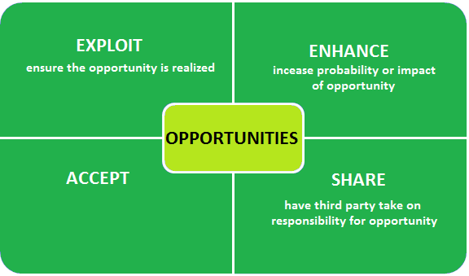

Plan Risk Responses Tools & Techniques (T&T)
Strategies for Positive Risks or Opportunities -

Slide 40
Plan Risk Responses Tools & Techniques (T&T)
Strategies for Positive Risks or Opportunities -
Exploit- The project team acts to eliminate the uncertainty associated with a particular upside
risk by ensuring the opportunity definitely happens.
Examples of directly exploiting responses include assigning an organization’s most talented resources to the project to reduce the time to completion or using new technologies or technology upgrades to reduce cost and duration required to realize project objectives.
Enhance- The project team acts to increase the probability and/or the positive impacts of an opportunity. Identifying and maximizing key drivers of these positive-impact risks may increase the probability of their occurrence.
Examples of enhancing opportunities include adding more resources to an activity to finish early.
Share- The project team acts to allocating some or all of the ownership of the opportunity to a third party who is best able to capture the opportunity for the benefit of the project.
Examples of sharing actions include forming risk-sharing partnerships, teams, special-purpose companies, or joint ventures, which can be established with the express purpose of taking advantage of the opportunity so that all parties gain from their actions.
Accept- Accepting an opportunity is being willing to take advantage of the opportunity if it arises, but not actively pursuing it.

Slide 41
Tools & Techniques (T&T)
2. Contingent Response Strategies -
Some responses are designed for use only if certain events occur.
– Risk responses identified using this technique are often called Contingency Plans or
Fallback Plans and include identified triggering events that set the plans in effect.
The project team make a response plan that will only be executed under certain predefined conditions, if it is believed that there will be sufficient warning to implement the plan.
Events that trigger the contingency response should be defined and tracked.
Ex. Missing intermediate milestones or gaining higher priority with a supplier,
–
–
3. Expert Judgment -

Slide 42


Plan Risk Responses Tools & Techniques (T&T)
General Steps and Recommendation,
Several risk response strategies are available so analysis tools, such as decision tree analysis can be used to select one or mix of strategies most likely to be effective for each risk.
Specific actions are developed to implement the strategy, including primary and backup strategies, as necessary.
Identify & Assign one person (an owner for risk response) to take responsibility for each
agreed-to and funded risk response.
A fallback plan can be developed for implementation if the selected strategy turns out not to be fully effective or if an accepted risk occurs.
Secondary risks should also be reviewed. Secondary risks are risks that arise as a direct result of implementing a risk response.

